Slide 1


Exploratory Analysis of COVID-19 Mortality Risk Factors in the United States
Track D: Epidemiology of COVID-19
Group 5

Slide 2
Introduction and Objective
The current Covid-19 crisis has created an unprecedented public health and economic emergency
Current understanding of the virus spread and it’s mortality pattern is limited; however, significant amounts of data have been collected and made publicly available
Objective: To find the relationship of the sociodemographic and health service factors with the COVID-19 mortality in the United States.
Study GitHub repository: github.com/AmirAvnit/COVID-19_MIT_DataThon_Team_E5

Slide 3
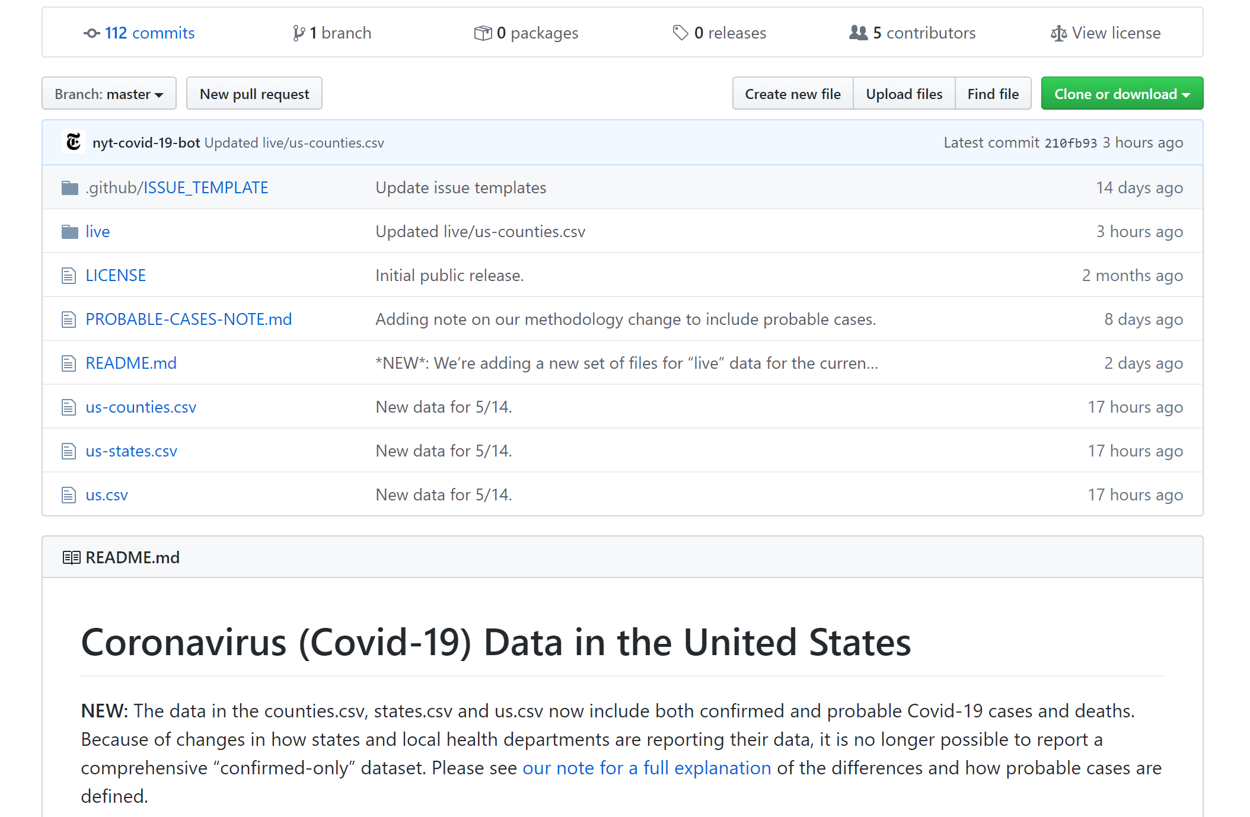
Methodology Overview
We used counties as our observation unit
Data was collected, preprocessed and analyzed via R and python
R packages: pscl and parameters
Python libraries: numpy, pandas, scipy and sklearn
Data was visualized via Tableau, R and python
R packages: ggplot2
Python libraries: matplotlib and seaborn
Notes:
We merged data on 3,000 counties across the US from different sources.
We used both Python and R for data preprocessing and analysis,
And R, python and Tableau for creating visualization.

Slide 4
Data Collection
Open-source datasets were explored for potential predictors of COVID19 mortality
Housing & population per Area
Availability of health professionals
Hospital Bed and ICU Capacity
Lockdown Length
COVID-19 County Level Data
Socioeconomic, Behavioral & Life Quality rankings
Morbidity, Obesity & Smoking Prevalence
Sources: https://www.usatoday.com/storytelling/coronavirus-reopening-america-map/ https://github.com/nytimes/covid-19-data https://github.com/JieYingWu/COVID-19_US_County-level_Summaries
All datasets and our processed data can be found in the study’s GitHub repository: github.com/AmirAvnit/COVID-19_MIT_DataThon_Team_E5

Slide 5
Data Preprocessing
Multiple relevant open-source datasets were examined and obtained
Irrelevant variables and variables with high numbers of missing values were omitted (25% or above NAs)
Cases with missing values for predicted variable (death rates) were omitted
Variables were normalized according to county population size (1 per 1,000 people)
All processed data can be found on the study’s GitHub repository: github.com/AmirAvnit/COVID-19_MIT_DataThon_Team_E5

Slide 6
Feature Selection
A random forest model was trained on the data (n trees = 1,000). Then, 14 Features with Gini importance indices (mean decrease in impurity) > .002 were selected
Features having a Pearson correlation of r=.75 or above with another feature having higher Gini importance index were taken out (4 removed)
The remaining 10 features were included in the analysis:
# ICU beds; % Adult obesity; Quality of life rank; % Excessive drinking; Life expectancy rank; Population density (per mi²); Clinical care rank; % Adult smoking; # Specialists physicians; Physical environment rank
Notes:
For selecting the most relevant feature out of the 49 features we gathered, we trained a random forest with a 1,000 trees on the training data;
Then, we ranked the features by Gini importance index, indicating the amount of relevance each feature had for the model’s decision-making.
Using this method, we chose the most relevant 14 features surpassing a chosen threshold.
To reduce multicollinearity and use only features with strong unique relationships with COVID-19 mortality, we next examined the Pearson correlations between the selected features, and removed features having high correlations with one or more feature having higher importance values.
Finally, 10 features were selected for analysis, including, for example, number of ICU beds per 1,000 people, and percent of adult obesity.

Slide 7
Results and Key Findings

Slide 8
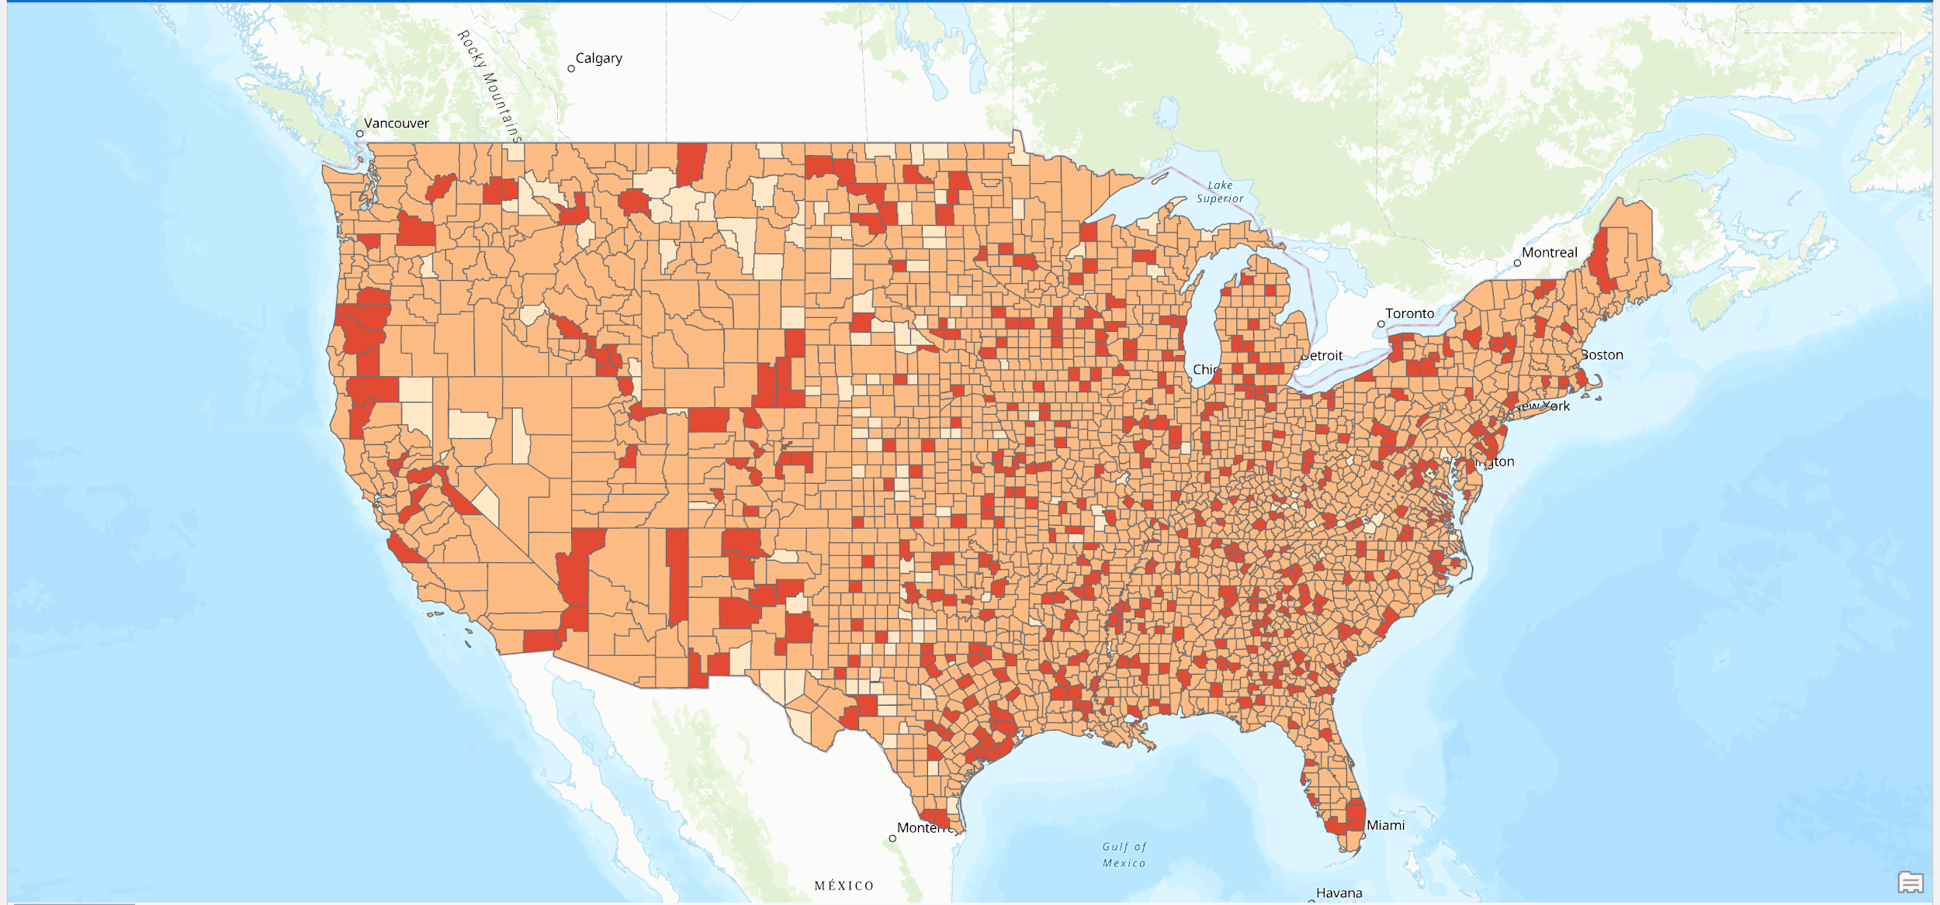
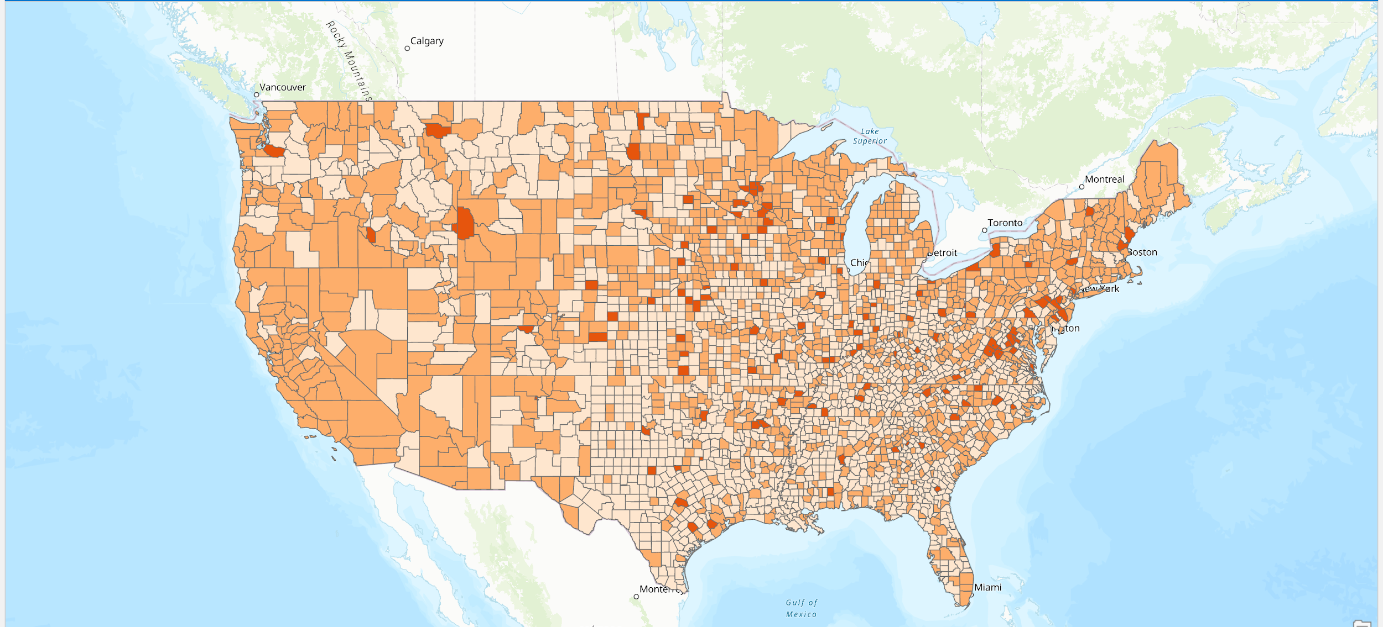
Virus Spread and Healthcare Workers by County
Healthcare workers
COVID-19 cases
Notes:
In this visual you can see the healthcare workers by county and the covid-19 cases by county
The dataset divided it into 3 feature classes (high, medium, and low)
So we did the same thing for the COVID-19 cases, but dividing it equally into 3 feature classes with the same number of cases in each class
There is a lot of overlap between the places where there are a so-called medium amount of health workers and where there are medium amount of cases especially on the west coast

Slide 9
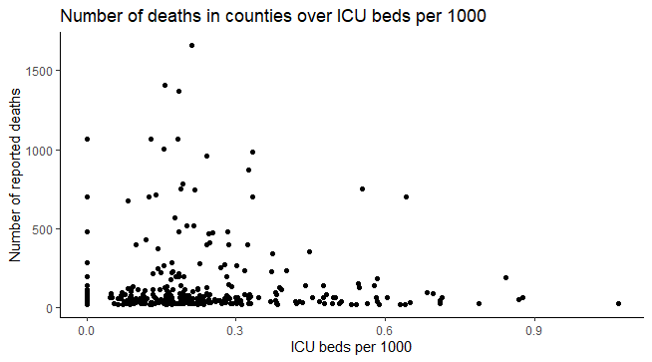
Notes:
At first glance you might not think there is a strong correlation between the ICU Beds and the number of reported deaths but there still is a correlation. But the main issue is that why are most of the counties clustered around the low area down here. The ICU Beds and reported deaths have a correlation but our focus should be on why are these countries starting off with low ICU bed numbers in the first place. So we looked at many factors indluig population density, lockdown times, and number of tests conducted to help adjust for graphs like these which then will give us a better overview of the data

Slide 10
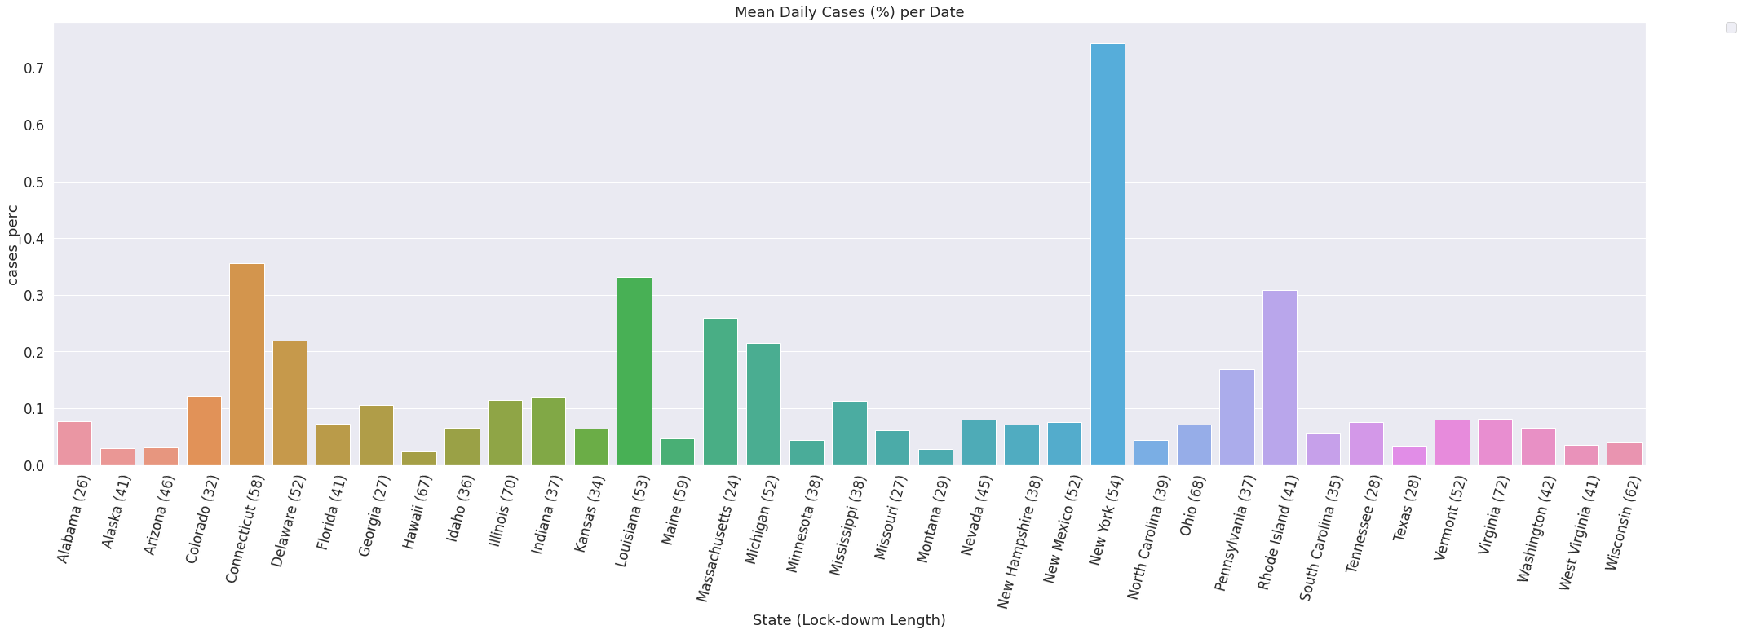
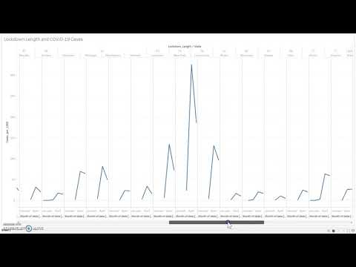
Lockdown and Average Daily Cases Per Day
Mean Daily Cases
COVID-19 Cases (%)
State (Lock-down Length)
Notes:
Here we have the lockdown data for each state and the number of days it spent in lockdown with the mean daily case percentage

Slide 11
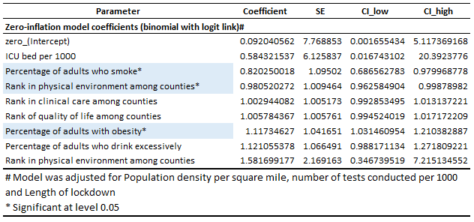
Regression coefficients
Notes:
To examine the relationships between the selected factors and COVID-19 morbidity, a negative binomial regression analysis was used, with adjusting for the population, length of lockdown, and correcting for the number of tests conducted.
We used zero-inflation for accounting for having null values for some features.
We found significant relationships for percentage of adult smokers, county rank in physical environment, & percentage of obesity in adults.
Physical environment encompasses factors such as air and water quality, existence of Housing Problems and daily commute length.

Slide 12
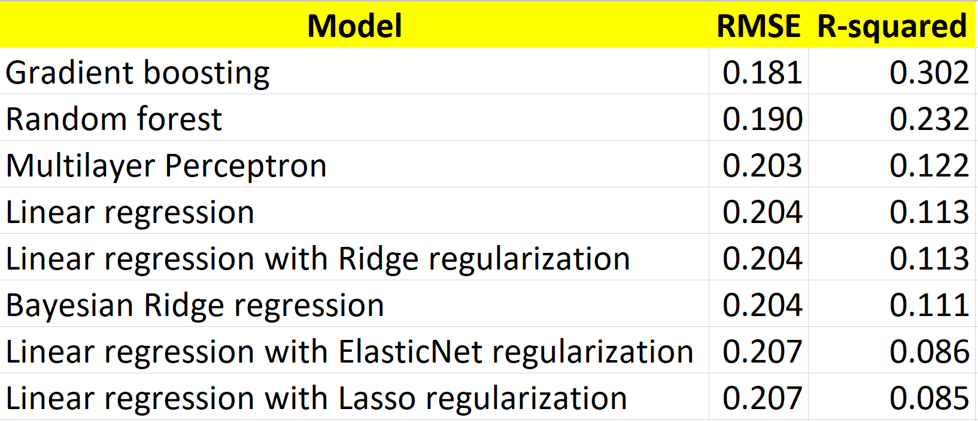
Machine Learning Findings
Data was randomly split into training and test subsets (75% and 25% of data, respectively), and models were trained and optimized
Best performance was obtained by a Gradient Boosting model, explaining 30.2% of the variance of COVID-19 mortality in the United States
Notes:
We next trained multiple machine-learning models, including decision tree ensembles, regression and a deep multilayer perceptron network, in order to examine the extent to which our selected features explain COVID-19 death rate.
We randomly split into training and test subsets, and each model were trained, optimized and evaluated.
Here we see the results of the evaluation process, depicted as root-mean square errors and r-square.
Best performance was obtained by a Gradient Boosting model, explaining 30.2% of the variance of COVID-19 mortality in the United States.
Gradient Boosting and Random forest: an ensemble of individual decision trees are trained on different parts of the same training set.
Model prediction is the mean of individual trees’ prediction.
Unlike random forest, In gradient boosting trees are not built independently, but rather are trained to improve shortcomings of previously trained trees; also, trees showing performance have more effect on model prediction.
Linear regression: models the relationship between two variables by fitting a linear equation to observed data, commonly optimized by minimizing the mean square distance between the line and training data points.
Multilayer Perceptron: is the deep neural network model that was created in order to better analyze the relationship between the individual predictive factors and COVID-19’s mortality rate

Slide 13
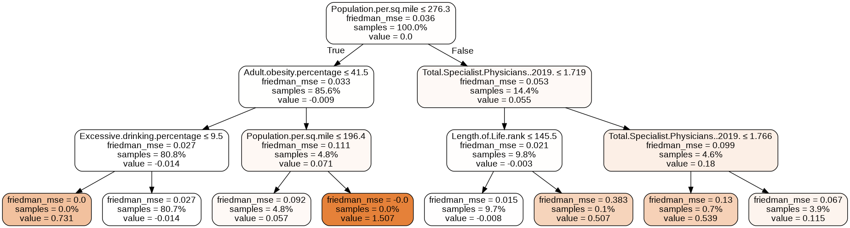
Example of a Gradient Boosting Decision Tree
Notes:
Here we see an example of a decision tree randomly picked from the Gradient Boosting ensemble.
We can see, for example, the a cut-off of having an adult obesity percentage cut-off of 41.5 percent for a county was highly influential on the decision obtained from this tree.
A decision is made at each branch according to a given rule, splitting the data in two ways.

Slide 14
Conclusions and Future Directions
10 factors uniquely related to COVID-19 mortality were obtained
Higher physical environment rank was found protective and higher proportion of obesity was found hazardous for death rates
A very high clinical relevance was found for ICU beds, although relationship with death rates was not statistically significant
Out of the models tested, Gradient Boosting showed the best performance, being able to explain 30.2% of the variance of the number of death cases in US counties
Going Forward:
Examine additional factors to explain more of the COVID-19 mortality variance
Examine the specific roles of different factors for different US counties
Obtain risk factors depending on location and individual attributes
The user inputs the county they are living in, their age, some demographic information (smoker, diabetic, etc.) and we output the probability of motarlity if the individual is infected with COVID-19
Notes:
We have found the majority of individual predictors using regression, decision tree ensemble and deep neural network techniques, while adjusting for numerous variables.

